Slide 1
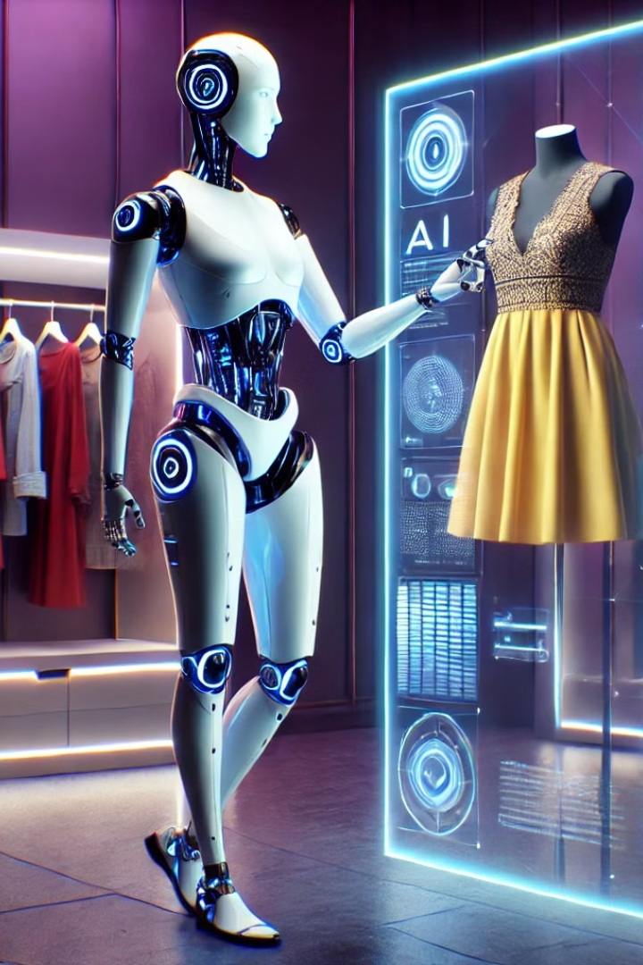
Infosys Springboard
AI Stylist: Personalizing Fashion Choices
Team:
1.Mohammad
2.Dheeraj
3.Shameera
4.Akshay
5.Lebin
Mentor :
Anil Shaw Sir

Slide 2
AI Stylist: Project Overview
1
Introduction
2
Project Goals
Understanding the AI Stylist project
What we aimed to achieve
3
System Architecture
4
Dataset Details
How the AI Stylist works
The data that powers the system
5
Collaborative Filtering
6
Content-Based Filtering
Recommendations based on user preferences
Recommendations based on visual features
7
Comparing Approaches
8
Pre-trained Models
Content vs. collaborative filtering
VGG16, DenseNet, MobileNet

Slide 3
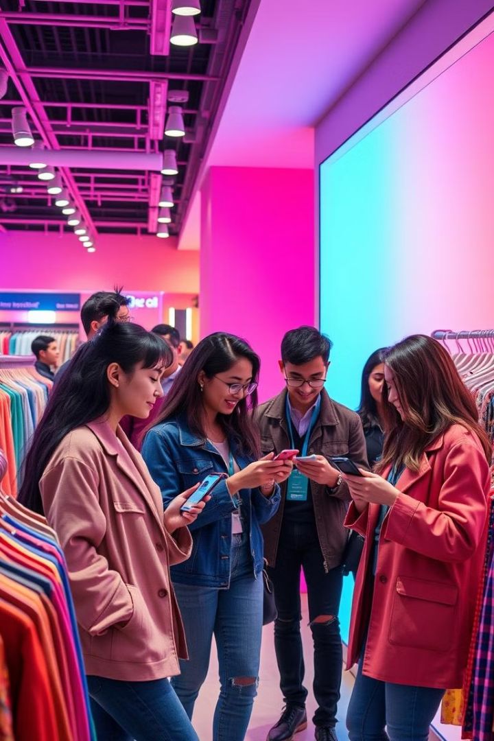
Empowering Personalized Style
Goal: create an AI-powered personal stylist that helps users discover new styles, find clothing they love, and express themselves confidently.
Develop an AI-based system to recommend clothing items.
Enhance user experience with personalized and visually appealing suggestions.
Leverage data and AI to match user preferences with suitable products.

Slide 4
AI Stylist: System Architecture
User Interaction
Image Processing
Recommendation Engine
User Feedback
Input: User preferences, style goals, and visual queries
Analyzing clothing images, extracting visual features
Learning from user interactions and improving recommendations
Content-based and collaborative filtering algorithms

Slide 5

Dataset: Fashion Insights
Dataset: millions of clothing images, tagged with attributes
such as brand, style, color, size, and price.
Purpose: Provides data to recommend clothing items.
Features:
Product Details: Name, category, price, and brand.
User Behavior: Ratings, reviews, and purchase history.
Visuals: Images of clothing items.

Slide 6
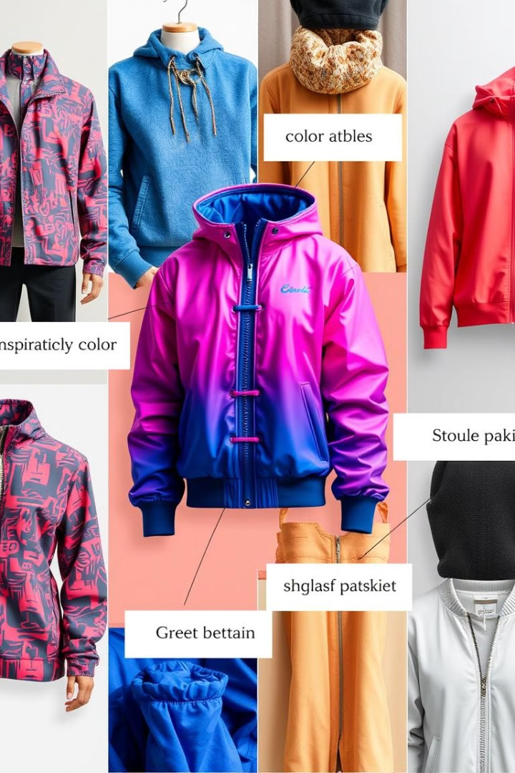
Content-Based Filtering
Definition: Content-based filtering recommends items similar to what a user likes by analyzing
features. These features could include attributes like color, style, genre, or keywords etc..
How It Works: Uses item features (e.g., style, color, material) to compute similarity between products.
Tools/Techniques: TF-IDF, cosine similarity, embeddings.
Example: A user buys a round neck t-shirt. The system recommends similar items with different types of round neck t-shirts based on similar pattern.

Slide 7

Collaborative Filtering
Recommends items based on user behavior or preferences.
User-based: Suggests items liked by similar users.
Item-based: Recommends items frequently liked together.
Example: A user buys a shirt, and the system recommends matching pants based on what others who bought the same shirt also purchased

Slide 8
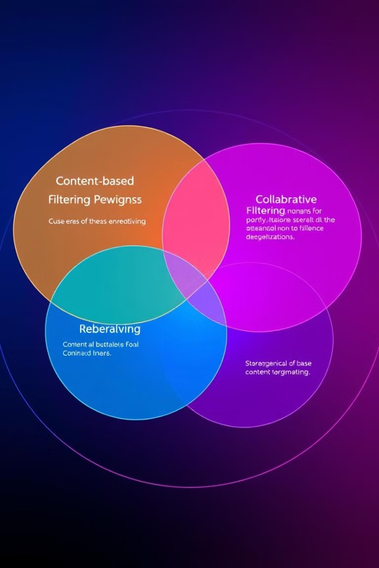
Content vs. Collaborative Filtering
Content-based filtering focuses on visual similarity, while collaborative filtering considers user preferences and interactions.
Content-Based Filtering: Recommends items based on their features (e.g., style, color, material). Suggests similar items to those a user has liked before.
Collaborative Filtering: Recommends items based on user behavior and preferences. Suggests items liked by other users with similar tastes.

Slide 9
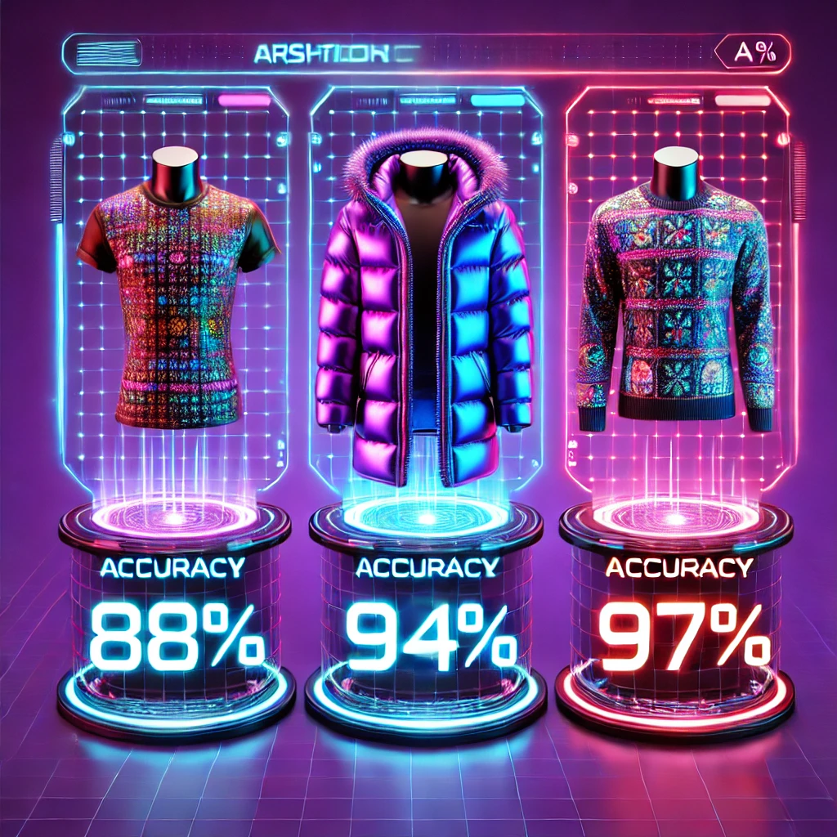
Leveraging Pre-trained Models
MobileNet
A lightweight, efficient CNN architecture designed for mobile and embedded devices, prioritizing speed and low resource usage.
DenseNet
A CNN model that connects each layer to every other layer to improve feature propagation and reduce parameters.
VGG16
A deep CNN model with 16 layers, known for its simplicity and use of small convolution filters (3x3) for image classification tasks.

Slide 10
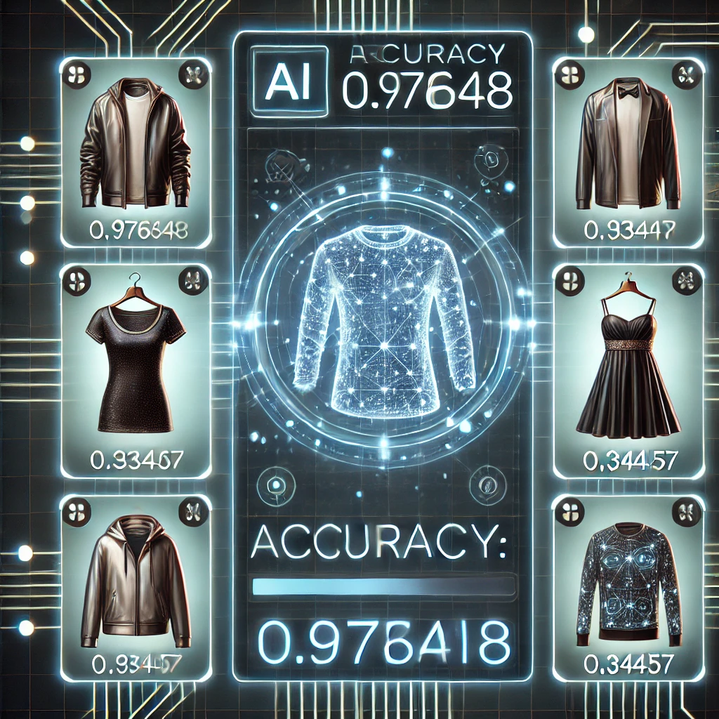
precision in Every Choice
Our AI-powered recommendation system combines cutting-edge machine learning and deep learning techniques to deliver highly personalized and Visually engaging recommendations. We enhanced our dataset by transforming raw IDs into identifiable image filenames and leveraged the VGG16 model, chosen for its proven ability to extract rich, high-dimensional image embeddings that capture Complex visual patterns.
By calculating cosine similarity on these embeddings, the system intelligently ranks and suggests visually similar products, ensuring users discover items that align closely with their preferences. Rigorous training, iterative optimization, and evaluation using metrics like accuracy, precision, and F1-score have resulted in a highly reliable and seamless recommendation experience, revolutionizing how users explore and find products.

Slide 11

Thank You!
Thank you, Infosys-springboard, and my mentor Mr. Anil Shaw for your
guidance and support. Grateful to my team for their collaboration and
dedication throughout this journey..

